Slide 1

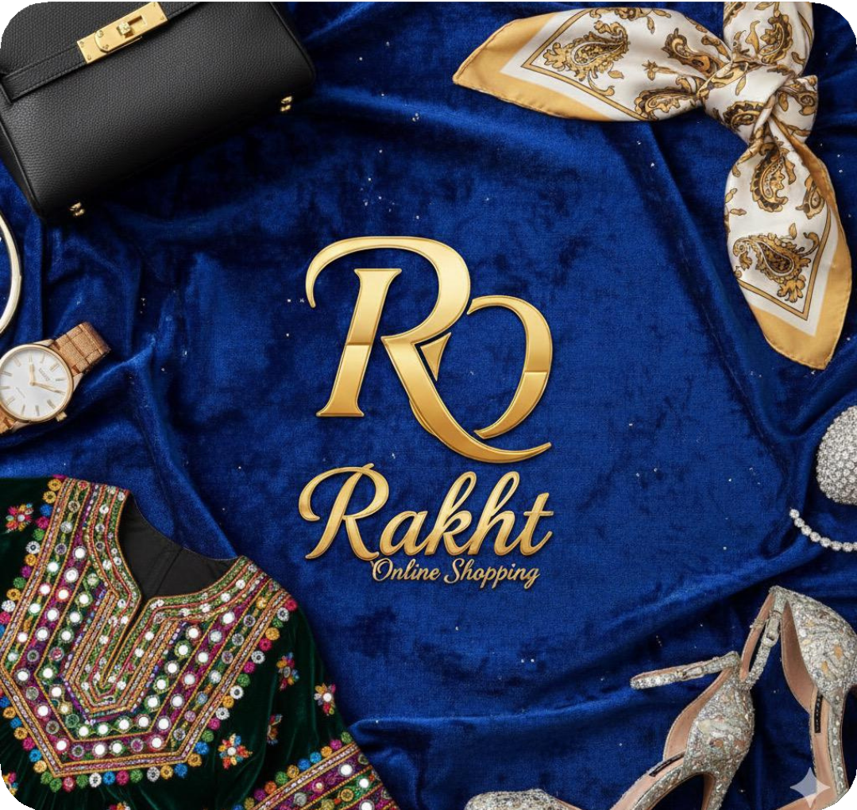

Rakht Online Shopping
Presented by: Aisultan Azmoon, Farida Sultanpur, Muhammad Mustafa Hakimi, Kereshma Fakhri
Professor Shamroz Masjidi

Slide 2


Executive Summary
Rakht is a Kabul-based online clothing marketplace that specializes in reasonably priced, fashionable, and culturally relevant clothing. The company provides both ready- made and customizable clothing that combines contemporary styles with traditional Afghan clothing.
Uses a lean, founder-led business strategy with effective logistics and little overhead.
Startup capital: 50,000 USD carefully distributed
among reserves, technology, logistics, and inventory.
Year 1 net profit: 6,933 USD (17.1% margin), full
recovery in 14.8 months, and break-even by Month 2.

Slide 3
The Problems
Women and young people have little access to reasonably priced and varied fashion options
Current online retailers lack flexibility, professionalism, and reliable delivery services.
the retail clothing business in Afghanistan is divided, unstable, and lacking in variety.
Why It is difficult for customers to find both traditional and modern styles at one location.

Slide 4




The greatest online retail category in Afghanistan is clothing
The country's youth population is expanding quickly, and e- commerce is becoming more popular (AfterShip, 2025).
Online purchasing is made possible by the ongoing expansion for handheld broadband access.
Market Opportunity
The 15–45 age group has a high need for current, culturally suitable apparel.

Slide 5

Target Market
Primary Customers: Young people between the ages of 15 and 45 college students and young professionals and women looking for
modest, adaptable, and trendy clothes
Key Needs:
Stylish, reasonably priced options;
Dependable delivery Reputable online retailers with secure and efficient payment options

Slide 6

Industry & Competitor Overview
Local businesses and tiny online retailers like Sale.af are competitors.
Current competitors' weaknesses: Inadequate logistics capabilities; Limited inventory
Unreliable service and quality
Afghan clothing Rakht covers the gap left by SMEs' weak distribution networks.

Slide 7

Afghanistan's Strategic Viability
More than 60% of people are under 25, a demographic that is heavily influenced by fashion.
As digital literacy rises, e- commerce is growing.
There is a strong demand for blended cultural and modern styles.
Encouraging local SMEs, particularly those run by women, improves the economy of the country

Slide 8

Value Proposition
Rakht provides ready- made and customizable alternatives in addition to stylish, reasonably priced, and culturally sensitive apparel
COD-based payments and dependable delivery.
More professionalism and choice than current tiny web retailers.
Ethical sourcing that supports regional women-owned clothing manufacturers.

Slide 9
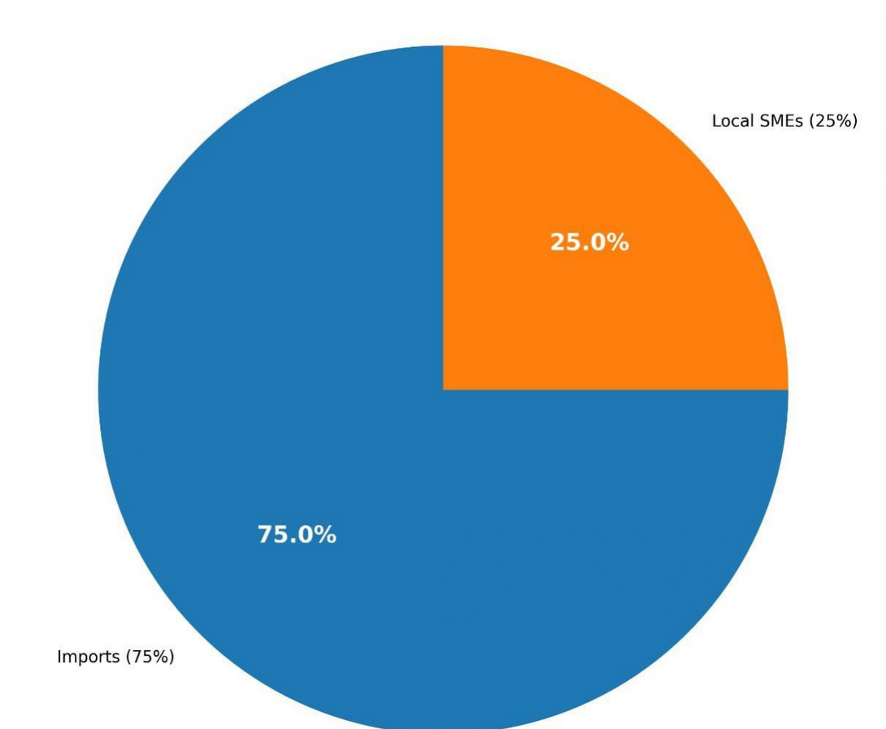
Business Model Overview
Product Mix: 25% locally made apparel and 75% imported.
Sales Channel: WordPress
+ AppPresser hybrid app
+ mobile-first website.
The most common method of payment is cash on delivery; digital gateways are not required.
Income: Delivery fees, direct sales, and data- driven enhancements.

Slide 10





Key Activities
Delivery and shipping operations digital marketing and consumer engagement;
website and app management inventory sourcing and quality control weekly analytics optimization using Python/R
supplier connections and workshop coordination

Slide 11

Key Resources
Four equity-based founders with expertise in technology, sourcing, analytics, and branding
50,000 USD in startup capital
a secure storage facility with backup power
a dedicated motorbike driver
an adaptive scaling platform hosted by DigitalOcean
and an established supplier network spanning Kabul workshops and import channels

Slide 12

Strategic Partnership
Local Afghan garment SMEs, especially women-led producers Import connections via China, Pakistan, and Iran
Payment service partners University communities for pop-up sales during outages
Retail advisor with significant workshop contacts in Kabul

Slide 13

pricing and marketing strategy
Cost:
13 USD is the average order value (AOV).
Orders over $65 qualify for free shipping. 35% is the profit margin.
Marketing:
Social media advertising (WhatsApp, Instagram, and services similar to TikTok)
An annual marketing budget of $3,000 USD
Evaluations, SME collaboration reports, and unboxing videos;
Data analytics for focused promotions (6.5%
anticipated uplift)

Slide 14





Operations Plan
Location: Storage in Kabul with solar and generator power backup
Infrastructure: daily backups, SSL security, and cloud hosting from DigitalOcean.
Logistics: About 25 items are delivered daily by a motorcycle transport; a second driver is added after 600 orders per month
Founders: They reduce fixed expenses by managing full-time without receiving a compensation.

Slide 15

Requirements for Technology
Future custom app reserve (5,000 USD) WordPress + AppPresser setup (2,000 USD) Cloud web hosting: 10–20 USD per month;
Python/R inventory analytics;
power outage backup systems;
SSL and cybersecurity monitoring
Paid Positions:
300 USD per month for retail advisors and 350 USD per month for shippers
Founders (unpaid):
Security and technology Data analytics and finance; marketing and branding; inventory and supplier management The total yearly cost of personnel is 7,800 USD.
The structure of staffing

Slide 16
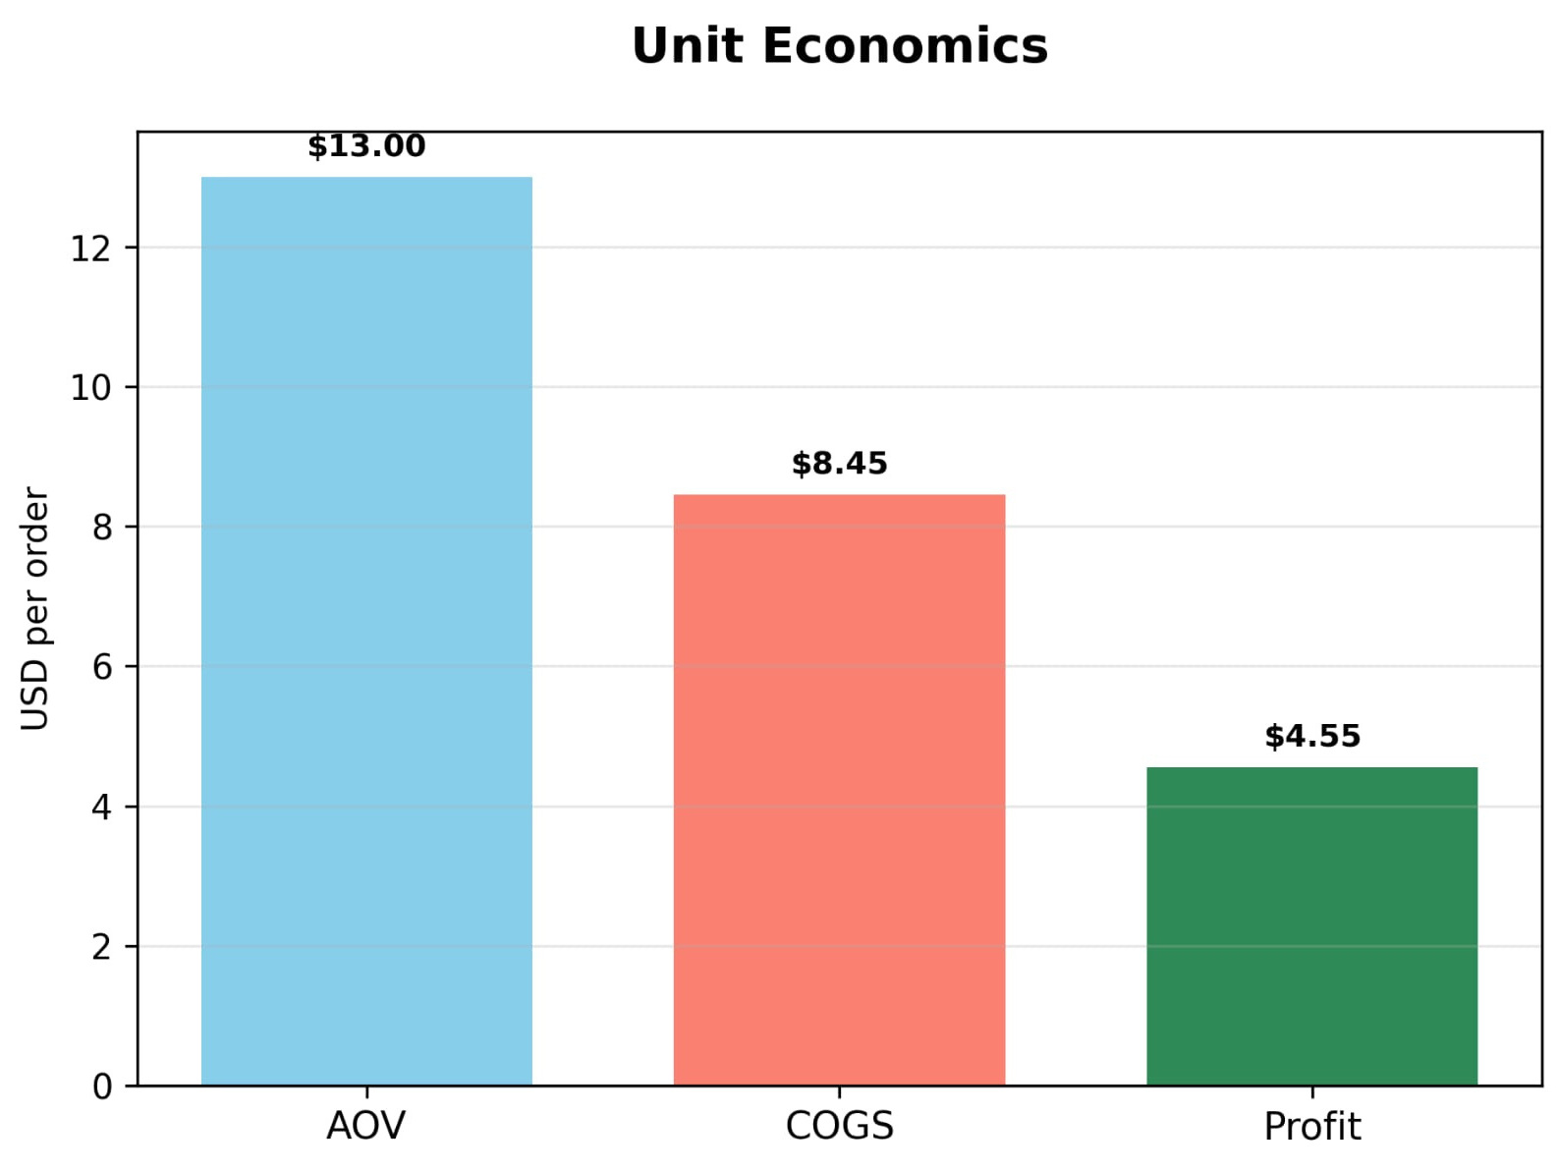
Financial Plan: Key Assumptions
2,000–10,000 monthly website visitors
1.8% conversion rate
25% repeat customer rate AOV: 13 USD
Inventory COGS: ~10.50 USD average
50,000 USD initial investment

Slide 17
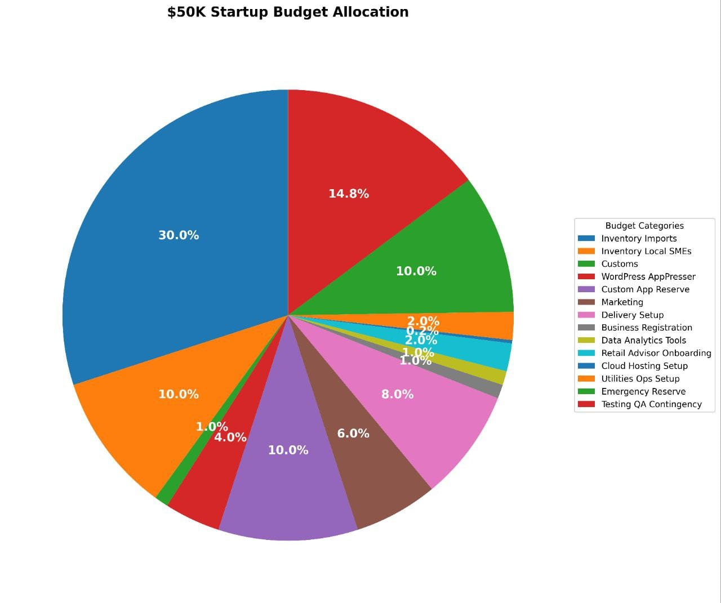
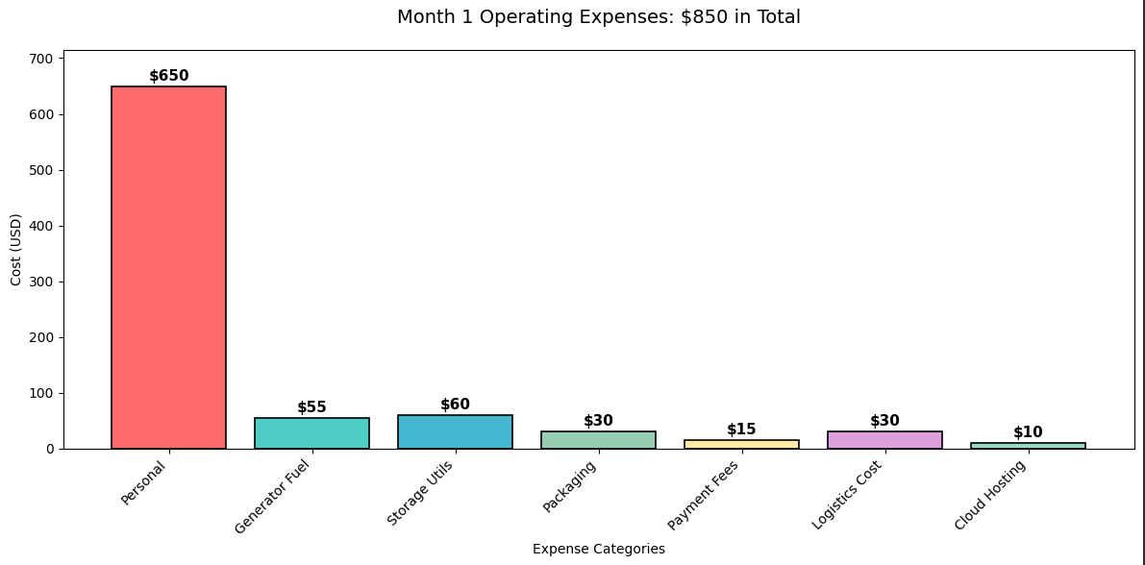
Startup Budget (50,000 USD)
Inventory: 20,500
App & platform: 7,000 Marketing: 3,000
Delivery setup: 4,000 Utilities & hosting: 1,620 Advisor onboarding: 1,000
Emergency reserve: 5,000
Contingency: 7,380
Total: 50,000 USD
Flexible budget

Slide 18
Year 1 Financials
Sales Revenue: 36600
Delivery Profit: 1140
Expenses: 32,487 USD Net Profit: 6,933 USD (17.1% margin)
Total Revenue: 40,420 USD
Break-even: Month 2 Full capital recovery:
14.8 months Analytics-driven revenue boost: 2,680 USD
Delivery Economics
5,700 orders/year
4275 shipping paying orders
1425 free shipping orders
Paid delivery: +1,710 USD
Free shipping cost: –570 USD Net delivery profit: 1,140 USD/year

Slide 19
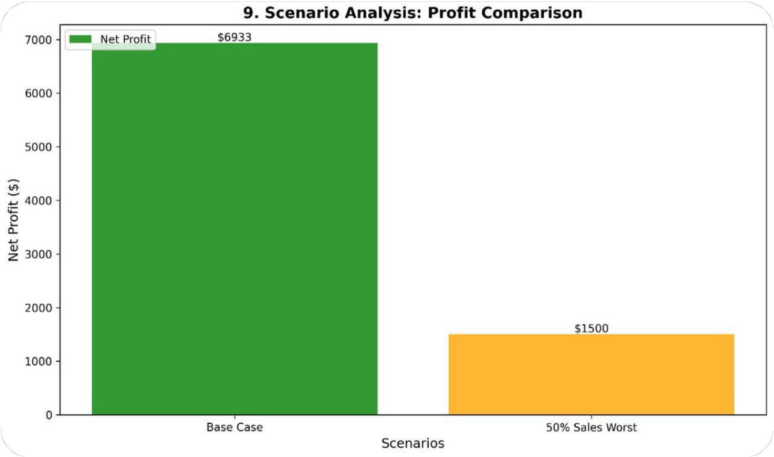
Risk Analysis
Political Risks
Risk analysis includes threats from ISIS-K, Sharia restrictions, and Taliban control; border closures that delay imports; and
internet outages.
Mitigation strategies include:
COD orders and minimal reliance on banks; local SME reserves to sustain operations; 25% Buffer backup communication via SMS and WhatsApp; and
an emergency reserve of 5k that continues for about six months.

Slide 20

Economic risks
fuel volatility, and widespread poverty that restricts demand Mitigation
strategies include:
fixed fuel compensation efficient motorbikes (45 km/L) solar and generator systems
and adjustable shipping and pricing criteria.
-Discounts and discount articles

Slide 21

Cultural and sales risks.
Low conversion or AOV are sales risks. Mitigation strategies include cheap overhead, flexible promotions, and weekly analytics changes.
Cultural Risks:
Women's limitations Mitigation strategies include modest apparel lines, men founders in public positions,
and female founders in distant roles.
Operational Hazards:
Shipping overload and power outages Mitigation: generator and solar power; additional shipment as required
Supply Chain Risks:
SME restrictions; import delays Mitigation strategies include a 48- hour turnaround capability, a varied workshop network, and a 25% local sourcing gap.
Operational and Supply Chain Risks

Slide 22
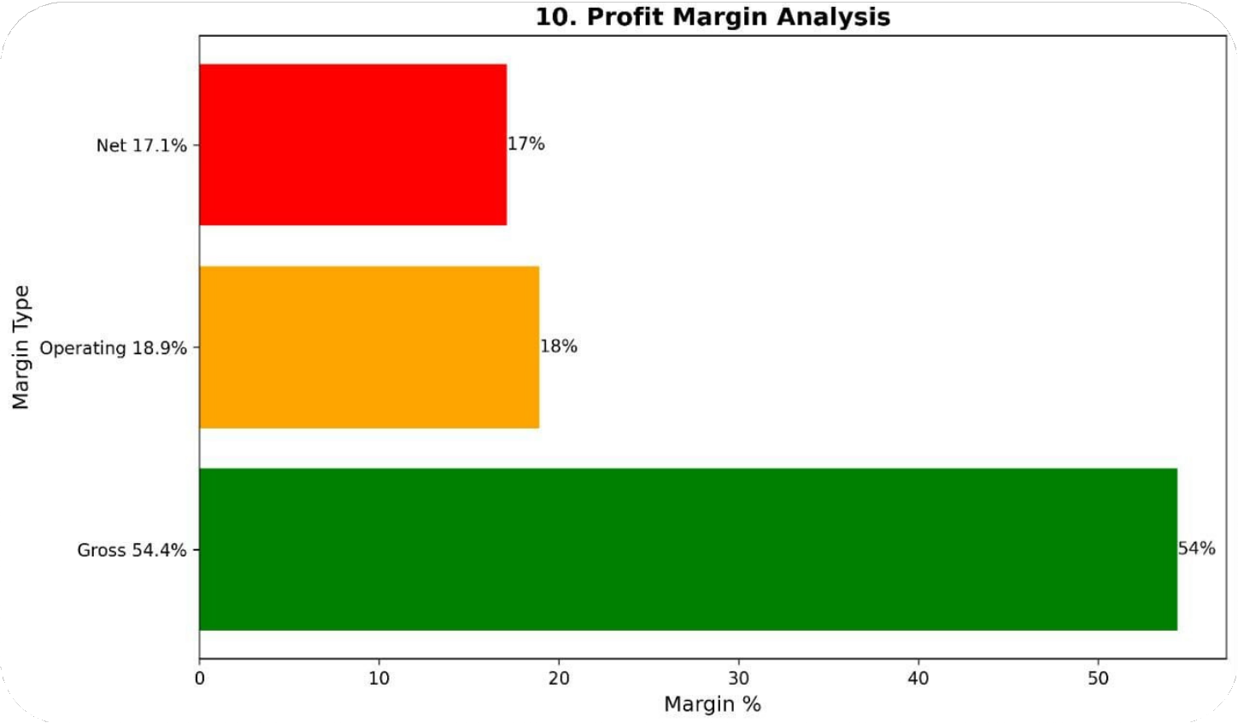
Conclusion
Rakht is a high-potential investment opportunity with a 17.1% net profit margin and a clear recovery timeline. Rakht provides a modern, financially viable solution to Afghanistan's divided clothing market. Strong margins, lean operations, and realistic analytics- based projections support stable growth. The company benefits Afghan SMEs, particularly women-led producers, as well as the economy.

Slide 23


THANK YOU
Q&A
Please feel free to ask us if you have any question

